Slide 1

Final Year Project Ideas
Haocheng Lin
Notes:
Main ideas: ask for references.

Slide 2
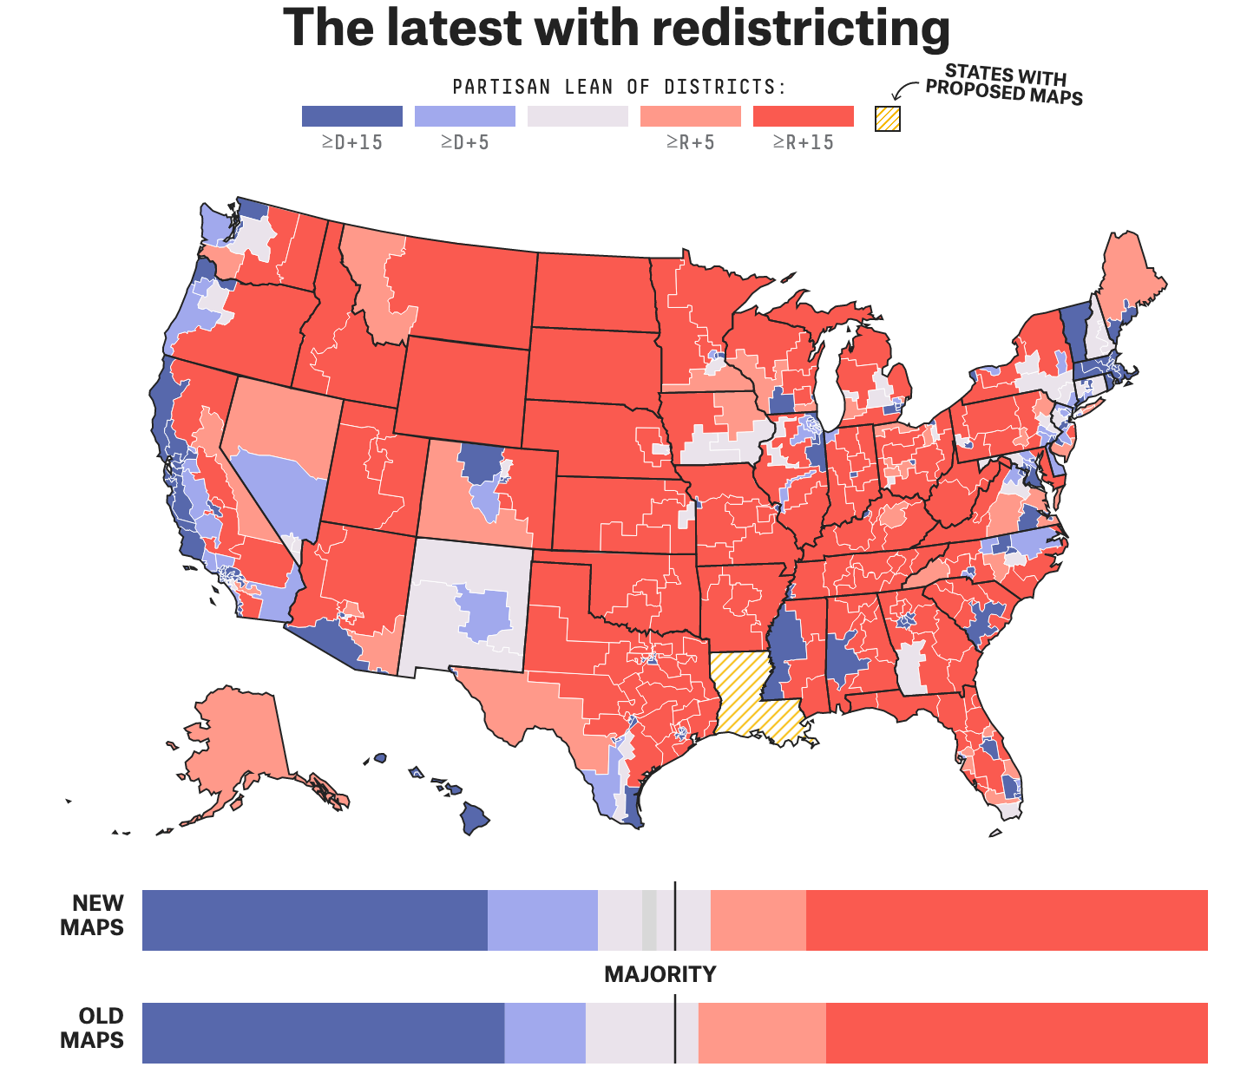
What is Redistricting?
Every 10 years, the Congress remaps the House of Representatives based on the population changes.

Slide 3
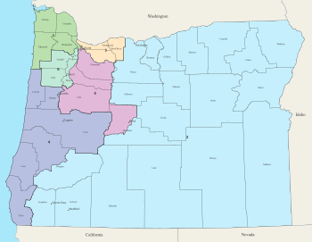
Redistricting project
Advantages: It is a practical application with many areas of application. The map has plenty of data, which can be used to create new congressional districts and forecast future election results.

Slide 4

Challenges
Current prototype are experiencing errors within the map library files. Current focus: think of researching new libraries.
Project complexity can either become too difficult or the complexity may not be sufficient for the level of final year project.

Slide 5


Redesign Protein Server Website
Programming Languages: JavaScript and ReactJS
Project has huge potential, and its requirements can extend if needed to suit the requirement.

Slide 6

Advantages
I have experiences implementing websites using JavaScript.
After viewing the website on the Protein structure, it is possible to meet the objectives and extend beyond the project requirements.

Slide 7

Maintaining machine learning algorithms
Continuous integration system
Which platform should we code from the continuous integration system?
Which data sets are we using for training and benchmarking?
Which set of criteria are we using to set for the benchmarks?
Notes:
Continuous integration system aims to build and test the code automatically. This occurs when a user pushes the code onto the repo.
Should we consider reinforcement learning? Reinforcement learning aims to improve the existing methods and ensure that the program will run better.
Continuous runs every test and pushes code when every test has passed.

Slide 8
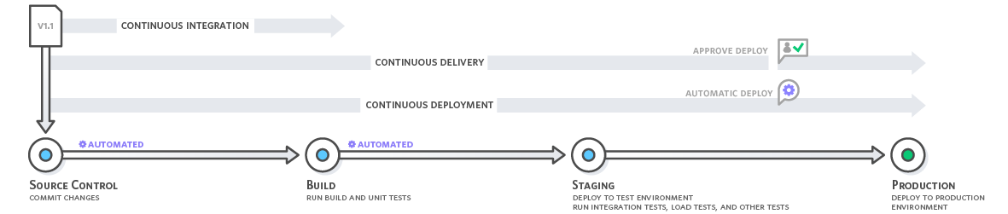
Continuous Integration Process
Notes:
Current repository limitation: it is difficult for teams to coordinate their repository updates
Goal: Automate the commits, build, stage and testing processes to ensure that the teams ca dedicate more time for other more important tasks.
Easier to update the changes and reduces the need for diverting a team for merging the different code versions.
Different teams working on different sections, which made merging code difficult. The current project has excellent application to help with improving the code versions.

Slide 9
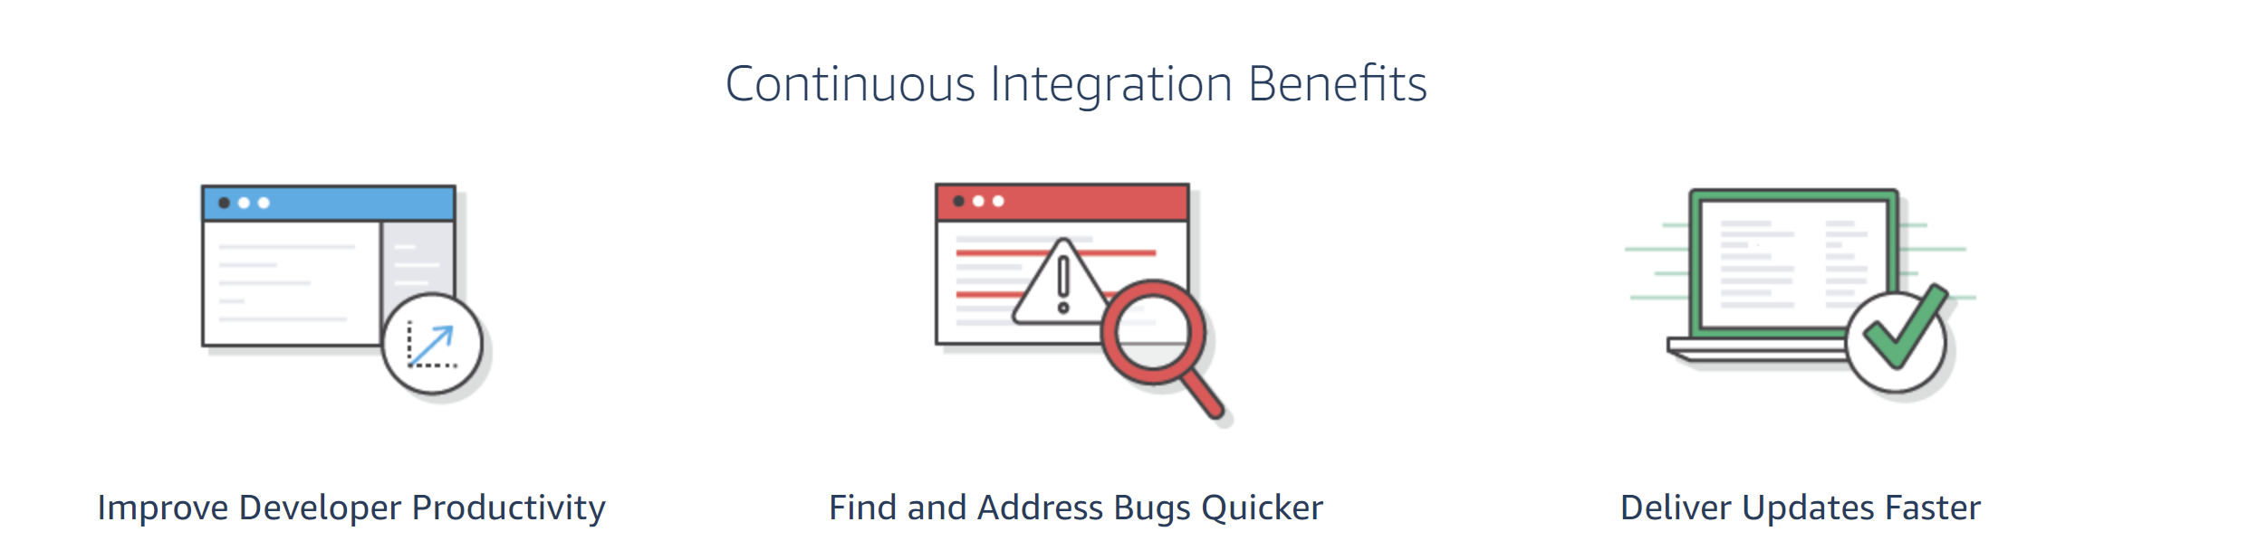
Why should we implement the new project?
Notes:
Through automation, it is possible to schedule new tests to identify and isolate bugs.
Reduces the need to focus on manual tasks throughout the project.

Slide 10
Server Roles
Build and documents the repository details for the user.
Makes it easier for the user to test, control, and commit their existing code.
The server ensures the code integrity.
Notes:
The server will be an online server to help different groups to integrate the different code sections.

Slide 11

Support JavaScript development.
Provides a build platform.
Easier for the user to implement the tests.
Protects the server from the other different users

Slide 12
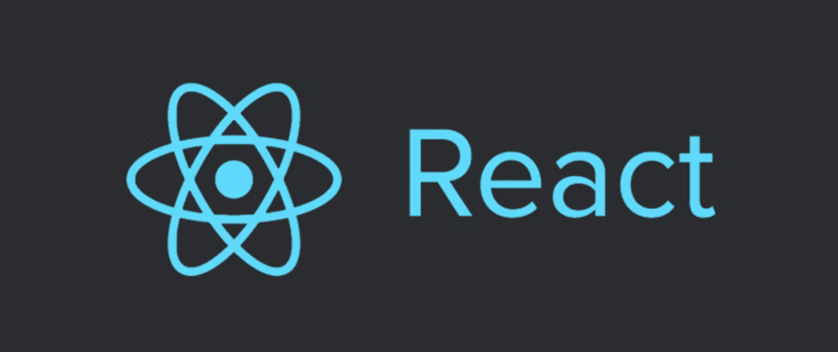
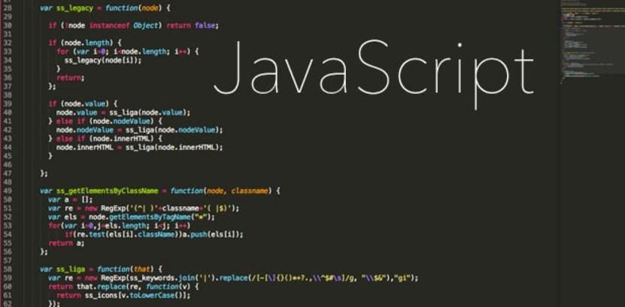
Languages
Notes:
Currently, most of the projects’ ideas involve further development of JavaScript. JavaScript is an important programming language for developing online applications and building new websites.

Slide 13
Projects ranked
1. Machine Learning Continuous integration tool
2. Redistricting Program
3. Reimplement Protein Web server and develop new protein structure annotation tool

Slide 14

Thank you for listening to my presentation

